Slide 1
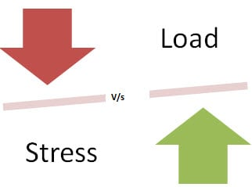
Load Testing Vs Stress Testing
Load Testing | Stress Testing
Load Testing is to test the system behavior under normal workload conditions, and it is just testing or simulating with the actual workload | Stress testing is to test the system behavior under extreme conditions and is carried out till the system failure.
Load testing does not break the system

Slide 2
וכיצד ניתן להשתמש בו בכדי לשפר את המערכת
Goals of Load Testing:
Loading testing identifies the following problems before moving the application to market or Production:
Response time for each transaction
Performance of System components under various loads
Performance of Database components under different loads
Network delay between the client and the server
Software design issues
Server configuration issues like a Web server, application server, database server etc.
Hardware limitation issues like CPU maximization, memory limitations, network bottleneck, etc.
Some of the issues that can be exposed during stress testing include:
When you’ve completed a round of stress testing, analyze the post-crash report to understand whether your application failed gracefully, as expected—or not.

Slide 3
הסבר/ י מדוע בדיקות יחידה ובדיקות קבלה אינן מכסות מקרים אלו
Results | Functional testing | Load & Stress testing
Predictability | Results of functional tests are easily predictable as we have proper steps and preconditions defined | Results of load tests are unpredictable
Changeability | Results of functional tests vary slightly | Load test results vary drastically
Frequency | Frequency of executing Functional Testing will be high | A frequency of executing load testing will be low
Dependency | Results of functional tests are dependent on the test data | Load testing depends on the number of users.

Slide 4
בחר/ י כלי המאפשר הגדרה והרצה של בדיקות קיבול ועומס של המערכת. ○
הדגם/ י עבודה עם הכלי. ○
הסבר/ י כיצד ניתן להשתמש בכלי זה בכדי ללמוד את צווארי הבקבוק במערכת )מגבלות על משאבים שונים והגורמים להם(.
Still confused? This is a helpful video about JMeter, an open source performance testing tool:

Slide 5
תאר/ י אוסף של תרחישי בדיקה למערכת המסחר המשמשים לצורך בדיקת קיבול ועומס.

